Slide 1
MACHINE LEARNING
Presented by:Navaneeth Krishnan Nair
USN:ENG19CS0201
Section:5th sem D-section​​

Slide 2

Introduction:
Machine learning is a method of data analysis that automates analytical model building. It is a branch of artificial intelligence based on the idea that systems can learn from data, identify patterns and make decisions with minimal human intervention.
Machine learning involves computers discovering how they can perform tasks without being explicitly programmed to do so.
It involves computers learning from data provided so that they carry out certain tasks.

Slide 3
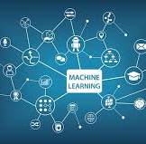
4) For simple tasks assigned to computers, it is possible to program algorithms telling the machine how to execute all steps required to solve the problem at hand; on the computer's part, no learning is needed.
5) For more advanced tasks, it can be challenging for a human to manually create the needed algorithms.
6) In practice, it can turn out to be more effective to help the machine develop its own algorithm, rather than having human programmers specify every needed step.

Slide 4
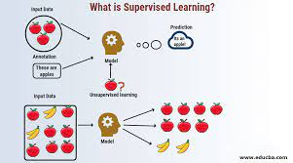
Supervised Learning:
Supervised learning is nothing but learning from someone.
Supervised learning can be separated into two types of problems when data mining—classification and regression:
Classification:It is a technique for determining which class the dependent belongs to based on one or more independent variables.
Regression:Regression is a supervised machine learning technique which is used to predict continuous values.
3) Supervised learning has features and labels

Slide 5
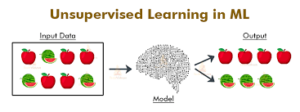
UNSUPERVISED LEARNING:
Unsupervised learning means learning by your own
Use deep learning to arrive at conclusions and patterns through unlabeled data
Example algorithms;K-means clustering,apriori

Slide 6
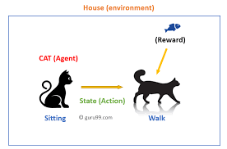
Reinforcement Learning:
Reinforcement learning involves reward and penalties.
Self interpreting but based on a system of reward and punishment learned through trial and error,seeking maximum reward.
Example algorithms:Q-learning,Model-based value estimation

Slide 7
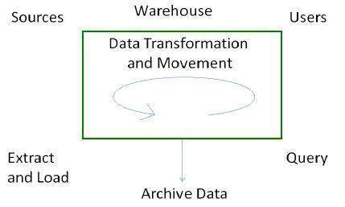
Process of data warehouse:
There are four major processes that contribute to a data warehouse −
Extract and load the data.
Cleaning and transforming the data.
Backup and archive the data.
Managing queries and directing them to the appropriate data sources
1)Extract and Load Process-Data extraction takes data from the source systems. Data load takes the extracted data and loads it into the data warehouse.
2) Clean and Transform Process-Once the data is extracted and loaded into the temporary data store, it is time to perform Cleaning and Transforming. Here is the list of steps involved in Cleaning and Transforming −
Clean and transform the loaded data into a structure
Partition the data
Aggregation

Slide 8
Backup and Archive the Data- In order to recover the data in the event of data loss,
software failure, or hardware failure, it is necessary to keep regular back ups. Archiving
involves removing the old data from the system in a format that allow it to be quickly restored
whenever required.
Query Management Process-This process performs the following functions −
manages the queries.
helps speed up the execution time of queris.
directs the queries to their most effective data sources.
ensures that all the system sources are used in the most effective way.
monitors actual query profiles.

Slide 9
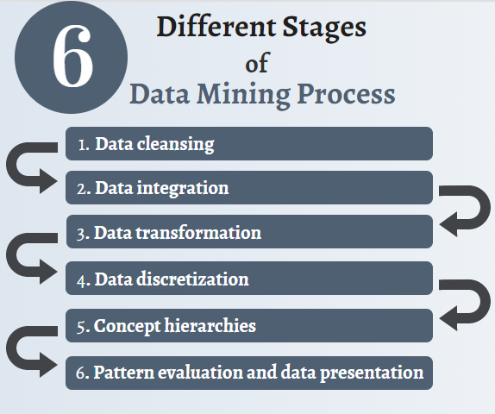
Process of data mining:
7 key steps in the data mining process –
Data Cleaning- Teams need to first clean all process data so it aligns with the industry standard. Dirty or incomplete data leads to poor insights and system failures that cost time and money. Engineers will remove all unclean data from the organization's acquired data.
Data Integration- This is one of the top mining techniques to streamlines the entire extract, transform, and load process.
Data Reduction for Data Quality- This standard process extracts relevant information for data analysis and pattern evaluation. Engineers take a small size of the data and still maintain its integrity during data reduction.

Slide 10
4) Data Transformation- Data transformation encompasses data mapping and other data
science techniques. Strategies include smoothing, or eliminating noise from data. Other popular techniques
include aggregation, normalization, or discretization.
5) Data Mining- Organizations use data mining applications to extract useful trends and optimize
knowledge discovery to generate business intelligence. This is only possible if a company takes full advantage
of big data and collects the correct type of information.
6) Pattern Evaluation- This is the stage where engineers stop working behind the scenes and
bring insights into the real world. Specialists will pinpoint any useful patterns that can generate business
knowledge.
7) Representing Knowledge in Data Mining- Finally, data analysts use a
combination of data visualization, reports, and other mining tools to share the information with others.
Before the data mining process even started, business leaders communicated data understanding goals and
objectives so engineers knew what to look for.

Slide 11
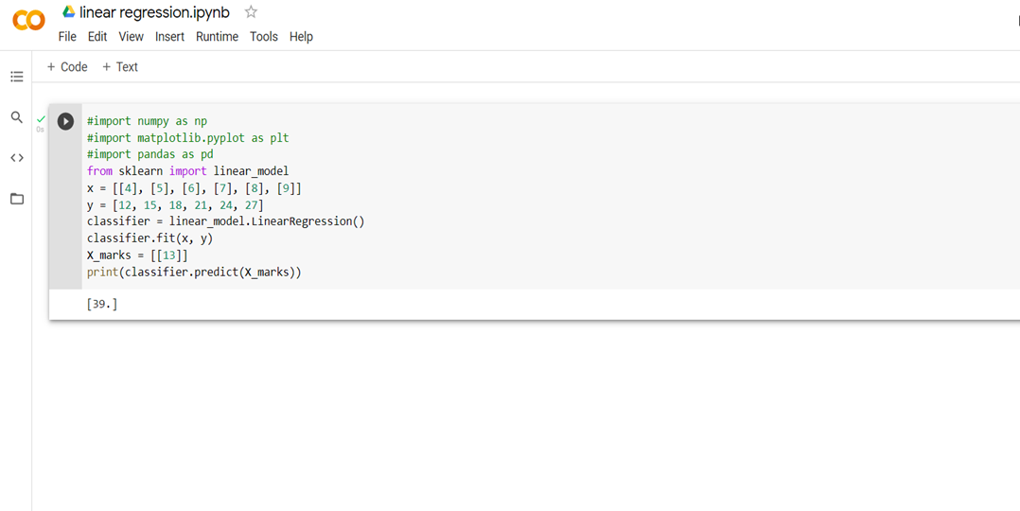
Machine learning algorithms
Linear regression: Linear regression is used in which value of dependent variable is predicted through independent variables. A relationship is formed by mapping the dependent and independent variable on a line and that line is called regression line which is represented by Y= a*X + b.

Slide 12
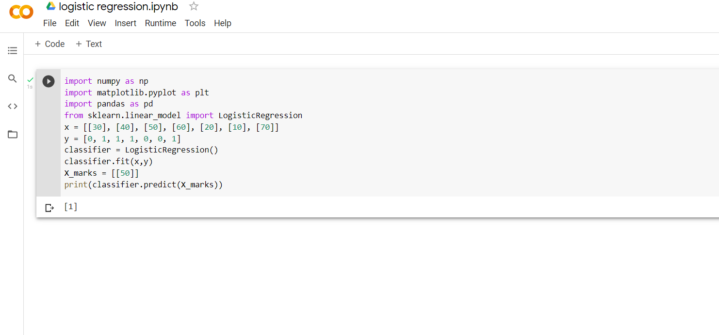
Logistic regression:Logistic regression is a process of modeling the probability of a discrete outcome given an input variable.
That is pass or fail, true or false, cat or dog, etc.

Slide 13
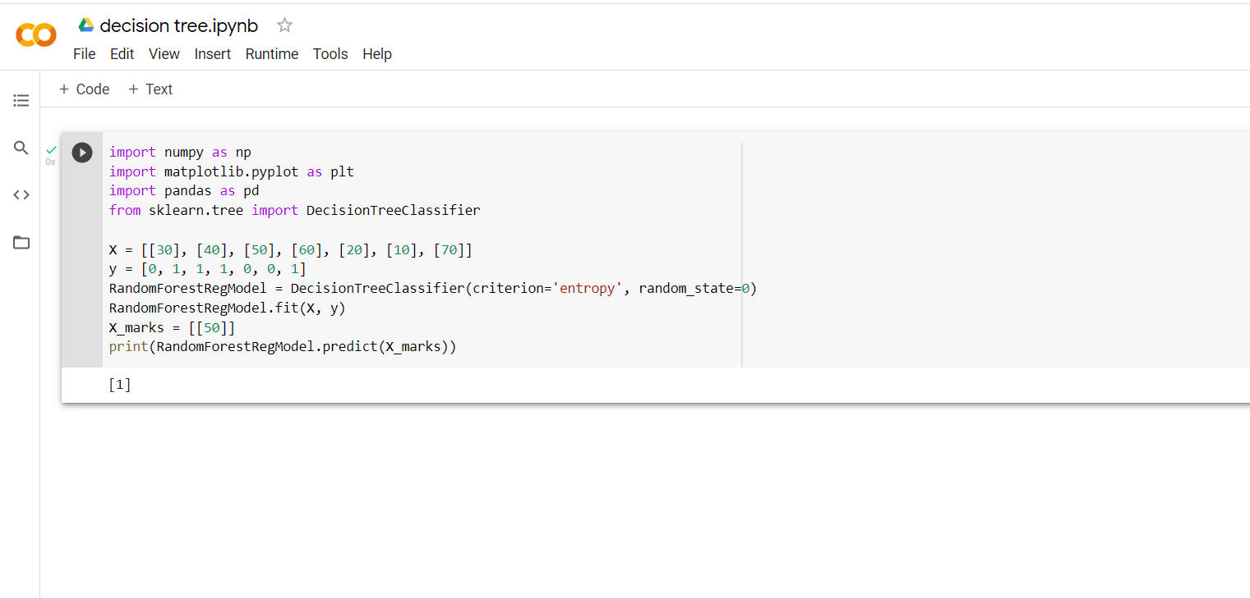
Decision Tree:It has a tree like structure which builds the best attribute as root, then splits the dataset into subsets.
Usually used to predict class or value of target variable.

Slide 14
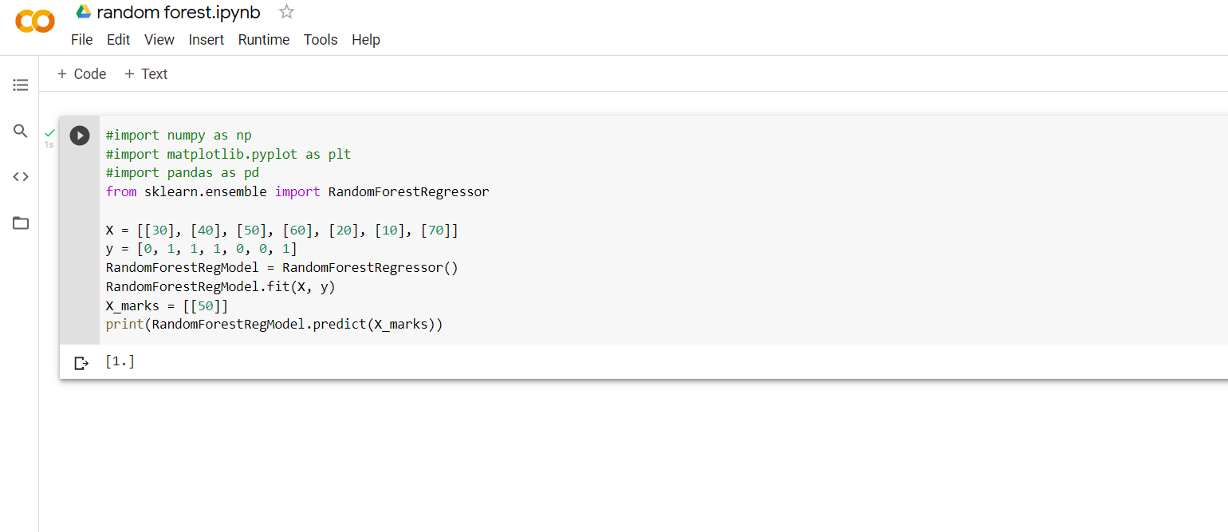
Random Forest:It comes under supervised classification algorithm.
Multiple number of decision trees together forms a random forest. It uses the rule of each randomly created decision tree and stores the predicted outcome and the most voted prediction is the final.

Slide 15
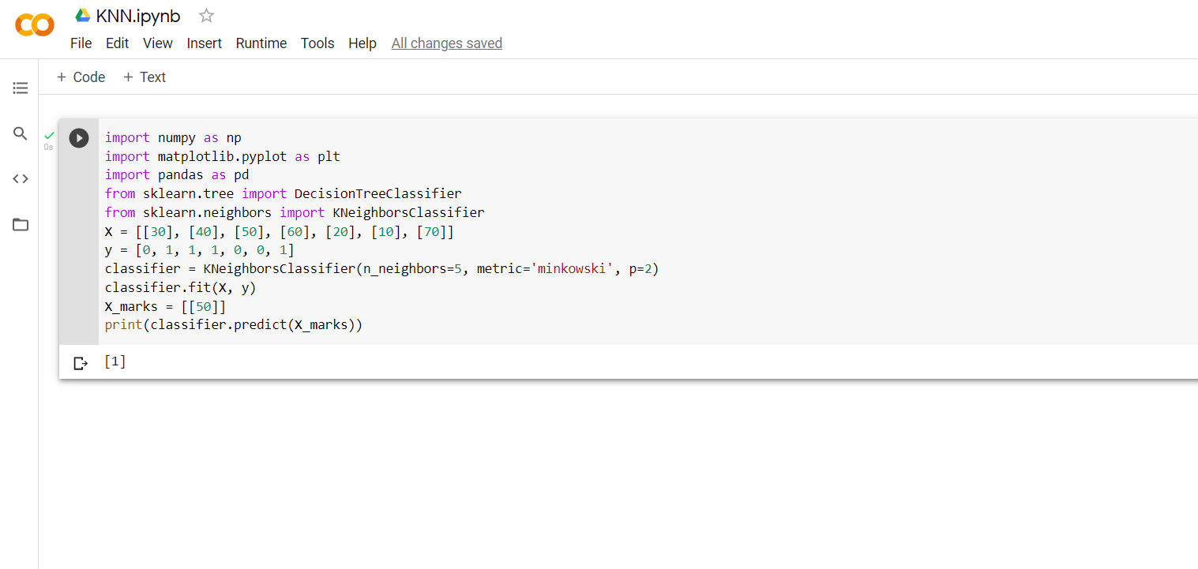
KNN K nearest neighbours:Used for classification and regression.
It simply compares the stored cases with the new data for majority of ‘k’- neighbours.

Slide 16
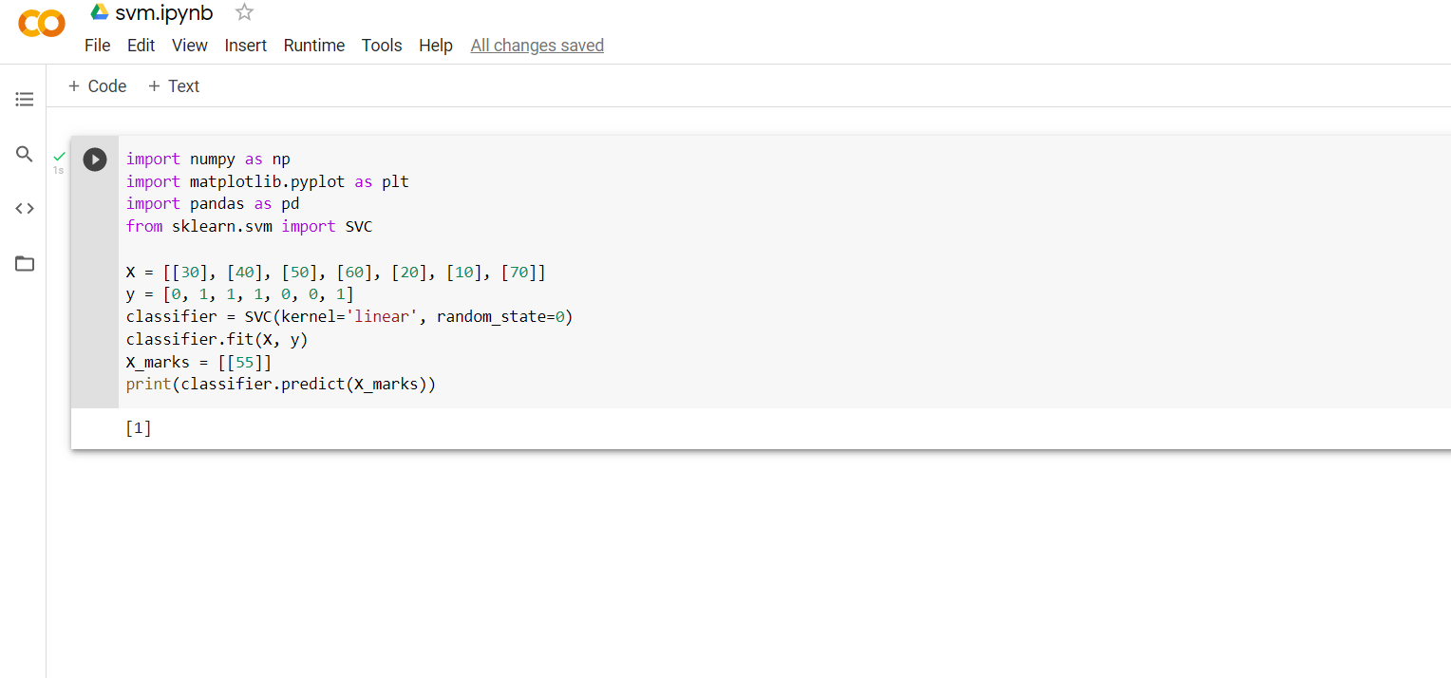
SVM:Stands for Support Vector Machine.
It ais a binary classifier. It differentiates the to closest given data-points.

Slide 17
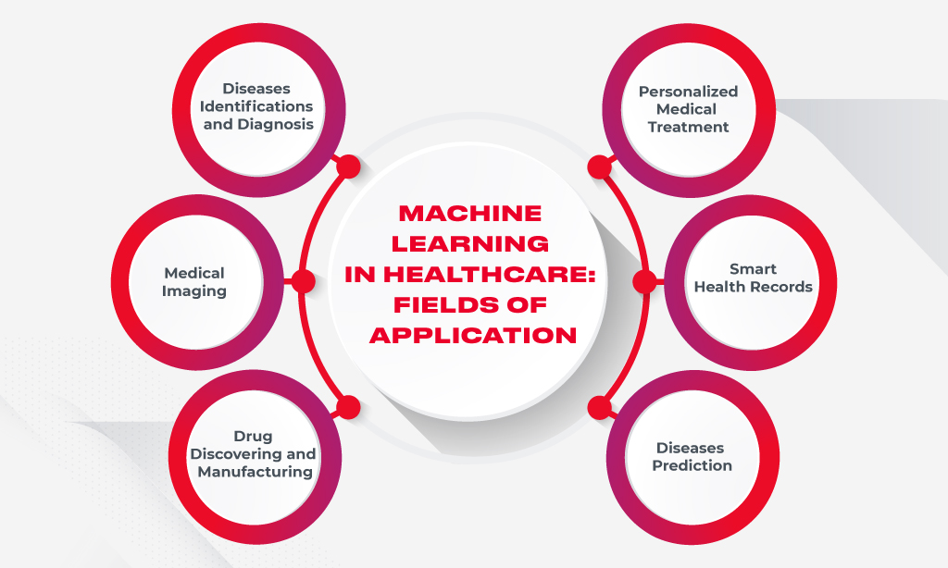
Applications of ml in healthcare:

Slide 18
Applications of ml in telecom:
Telecoms are bound to grow even bigger.
Machine Learning is a must.
Customer service chatbots.
Voice services and churn rate reduction.
Predictive maintenance.
Infrastructure for IoT and ecosystems.
Development of their own AI platforms.

Slide 19
Thank you

